Slide 1
Excretory system
Year 11 Biology
Bremer SHS

Slide 2
Learning Goals
• Students can recognise the different types of nitrogenous wastes produced by the breakdown of proteins
• Students can explain the function of each of the sections of the nephron and its function in the production of urine (glomerulus, Bowman’s capsule, proximal and distal tubules, Loop of Henle, collecting tubule)
• Students can explain how glomerular filtration, selective reabsorption and secretion across nephron membranes contribute to removal of waste.

Slide 3
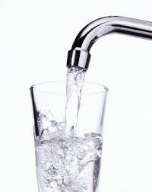
Water intoxication
Can be induced if drinking water at more than 16ml/min for a prolonged period of time.
Swelling of the cells in the brain can lead to seizures.
In January 2007, hours after competing in a KDND FM radio station contest to win a Nintendo Wii, 28-year-old Jennifer Strange was found dead in her California home. The station's "Hold Your Wee for a Wii" challenge awarded the game system to the contestant who could drink the most water without having to take a trip to the bathroom.
Jennifer Strange Story (first couple of minutes) –https://youtu.be/ioKDf-JvKDo

Slide 4
The excretory system
Responsible for removing excess, unnecessary materials from the body to help maintain balance and to prevent damage to the body.
Elimination of the waste products of metabolism as well as other liquid and gaseous wastes, as urine and as a component of sweat and exhalation.
Entire blood volume is filtered 60-70 times per day.
Average person excretes 1-2 litres of urine a day, so approximately 99% of the filtered water is reabsorbed.
Excretion ≠ Egestion
EXCRETORY SYSTEM
DIGESTIVE SYSTEM

Slide 5
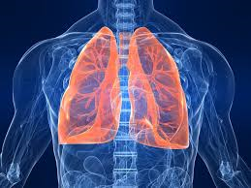
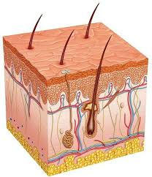
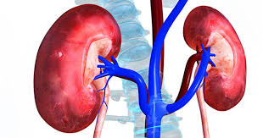
organs of the excretory system
The lungs in the respiratory system excrete some waste products, such as carbon dioxide and water.
The skin is another excretory organ that rids the body of wastes through the sweat glands.
The liver (via the intestines) excretes bile pigments that result from the destruction of hemoglobin. It also converts nitrogenous waste from the break down of proteins into urea.
The major task of excretion still belongs to the kidneys, the major organ in the urinary system. If it fails the other organs cannot take over and compensate adequately.

Slide 6
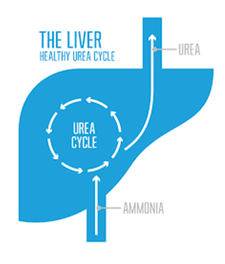
Nitrogenous wastes
Urea is the chief nitrogenous waste of mammals.
Most of our nitrogenous waste comes from the breakdown of amino acids. This occurs by deamination. Deamination of amino acids results in the production of ammonia (NH3).
Ammonia is an extremely toxic base and its accumulation in the body would quickly be fatal.
The liver contains a system of carrier molecules and enzymes which quickly converts the ammonia (and carbon dioxide) into urea.
This is called the urea cycle.
One turn of the cycle consumes 2 molecules of ammonia and 1 molecule of carbon dioxide to create 1 molecule of urea.

Slide 7
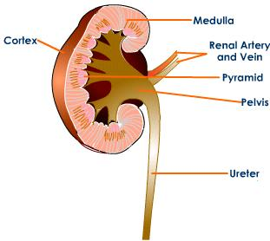
Parts of the kidney
Cortex - where the blood is filtered. Has nephrons for filtration
Medulla – contains the collecting ducts which carry filtrate (filtered substances) to the pelvis.
Pelvis – collecting tubules come together

Slide 8
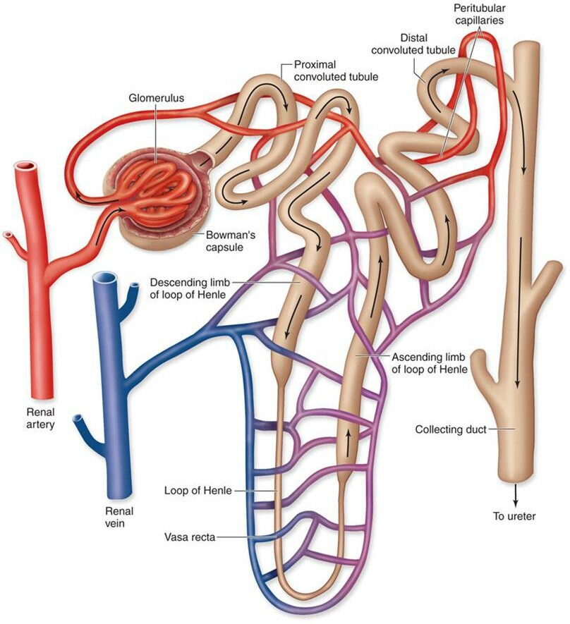
NEPHRON FUNCTION
1. Blood enters the kidney through the renal artery and then along arterioles to the nephron.
2. Water and most solutes (glucose, AA, Fatty acid, vitamins, minerals, salt) in plasma are filtered from the glomerulus and into the Bowman’s Capsule.

Slide 9
NEPHRON FUNCTION
3. All glucose, some water, amino acids and Fatty acids are reabsorbed (diffused) into blood in the Proximal Convoluted Tubule.
4. Salt diffuses in to the blood in the Loop of Henle.
5. Water is reabsorbed in the Distal Convoluted Tubule.
6. Collecting duct collects filtrate and concentrates into urine. Urine moves to pelvis of kidney, ureter, bladder, urethra.

Slide 10
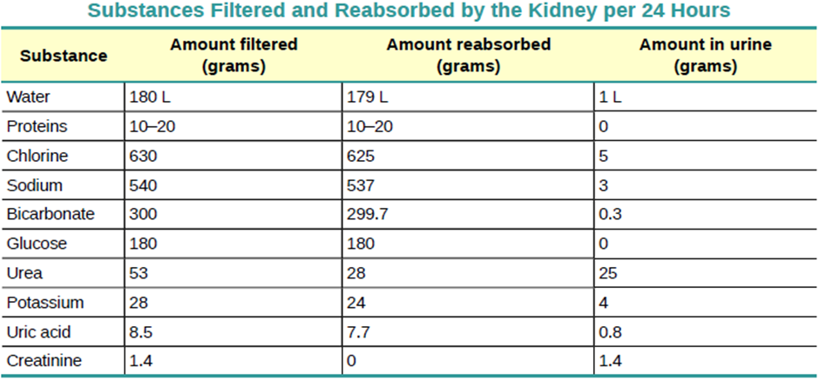
CHECK FOR UNDERSTANDING
Identify which column on the table is associated with substance concentration in the Bowman’s capsule and which is associated with the renal vein .
Identify the amount of sodium filtered by the kidneys per day.
Calculate the average amount of water filtered by the kidneys in a week.
Calculate the total concentration of substances in the urine per litre of water.
Explain why more urine is produced in winter compared to summer.

Slide 11
Check for understanding
Table 1 – concentration of potassium in kidney
Table 2 – standard deviation and p value for concentration of potassium in the kidney
 | Amount filtered (g) | Amount reabsorbed (g)
Patient 1 | 28 | 24
Patient 2 | 25 | 23
Patient 3 | 26 | 20
Patient 4 | 27 | 22
Patient 5 | 30 | 24
 | SD | P-value
Amount filtered | 1.9 | 0.004
Amount reabsorbed | 1.7
1. Calculate the mean for each of the independent variables.
2. Identify the independent variable with the highest variation in data. Justify your response by referring to data.
3. Suggest what the p-value for the data indicates.
4. Contrast the amount of potassium that is filtered with the amount of potassium reabsorbed.

